Slide 1
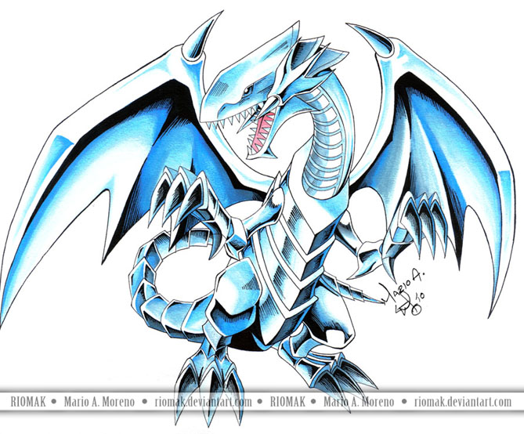
MY SCHOOL EXPERIENCE
BY:DEAN

Slide 2
SCHOOL IN GERMANY
School in Germany for me was a very strange thing for me. Everyone spoke a different language and there was a fair share of bullies. Plus I didn’t get a very good education because I wasn’t the best German speaker.

Slide 3
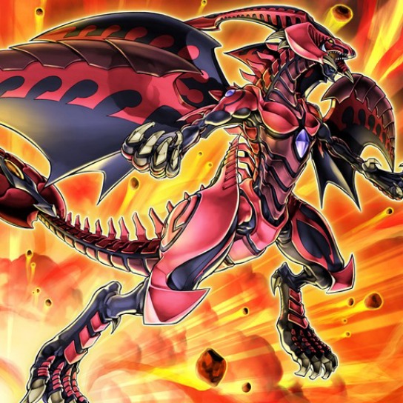
SCHOOL IN THE USA
Now I go to school in the states. I now have a good education and an even better school. I am now going to the school Mercer Middle School. Now I hope Mercer is just as good as my old elementary school, Pinebrook Elementary.

Slide 4
A LITTLE SOMETHING ABOUT ME: I like yu-gi-oh

